Slide 1
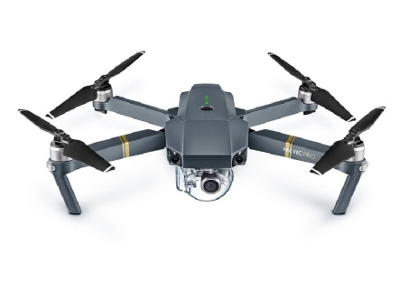
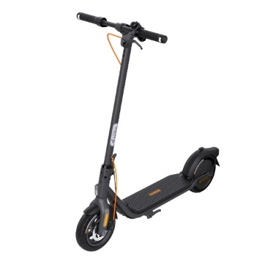
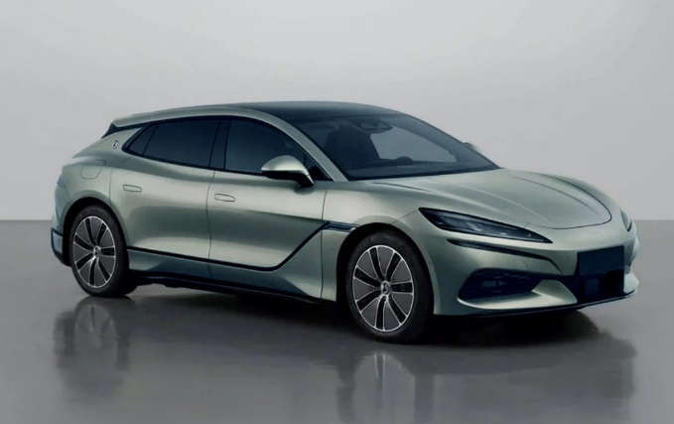
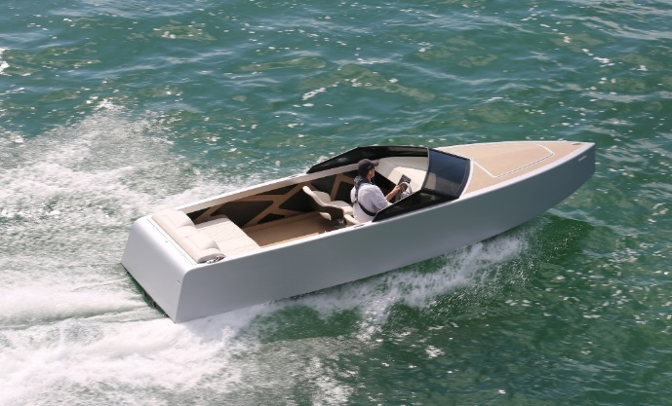
We believe that charging what you love should be simple and invisible

Slide 2
Problems with wired ev chargers

Slide 3
SOLUTION

Slide 4
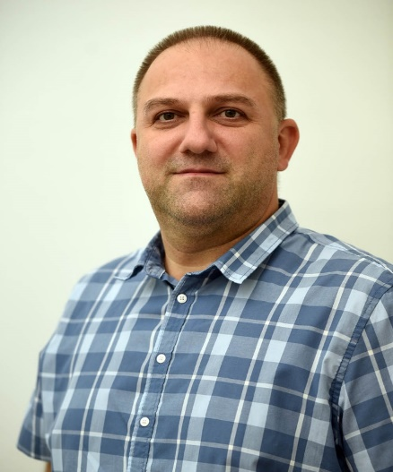
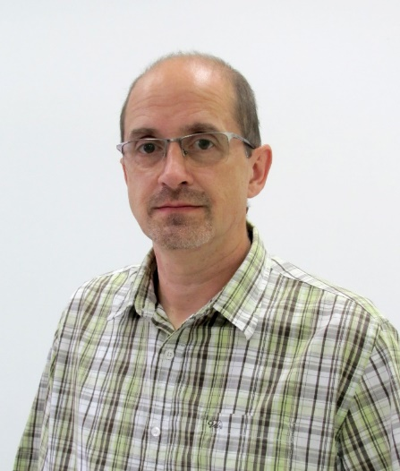
Leadership Team
CEO
Dejan Janjić MsC
COO
Branko Koprivica PhD
CTO
Aleksandar Spasojević
Business experience:
Leading family company for 20 years
Technical experience:
Designing low and high-power electronics
Project experience:
Project management
Protection of intellectual property
Technical experience:
Measurements and instrumentation
Project experience:
Production of electronic boards
Technical experience:
Assasment and analysis of electronic

Slide 5
OUR TEcHNological Solutions

Slide 6
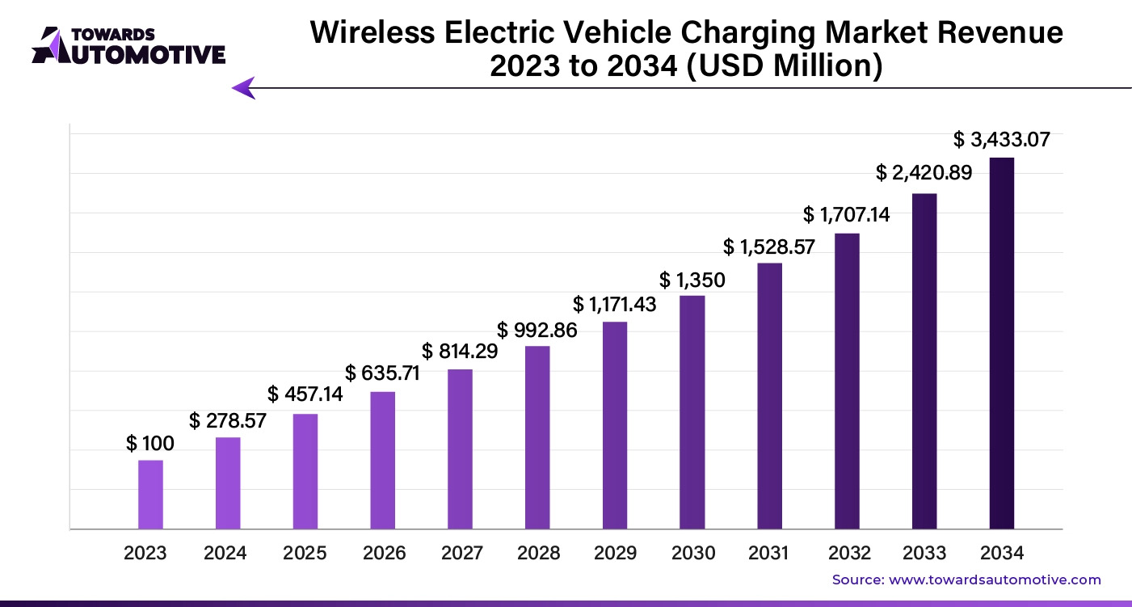
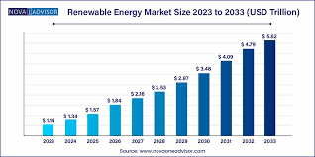
MARKET
Primary Target Market
Secondary Target Market

Slide 7
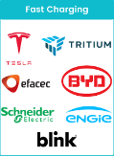
ENTERPRISE BUSINESS MODEL
Revenue Streams:
Key Customer Segments:
Reoccurring
LICENSE
Fees
EV vehicles and EV Chargers
Manufacturers
Energy Storage and
Smart grid Providers
Implementation services
One-time fees
Consulting services
Ad-hoc fees
Industrial Automation and Robotics Companies
Notes:
Key Activities:
Continuous technology development and improvement
Client onboarding and implementation
Ongoing support and consulting

Slide 8
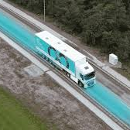
PARTNERSHIP WITH GOVERNMENTS AND AUTHORITIES
Participation in Initiatives and developments:
Dynamic wireless charging and electric road systems (ERS) developments!
Grid management and smart grid technology providers

Slide 9
OUR TECHNOLOGY Roadmap
Completed
Technology Readiness Level | TRL1-TRL5
Raised Funds | 150k €
Raising 5M € for 2025 to complete TRL 6 – TRL7
R&D Overcoming Wired EV Charger Limitations
Increase charging power to 22 kW
Intellectual Property Protection
Strategic Partnerships

Slide 10
Join us in charging the future.
Invest in a greener tomorrow!
www.wptenergy.com
office@wptenergy.com

