Slide 1
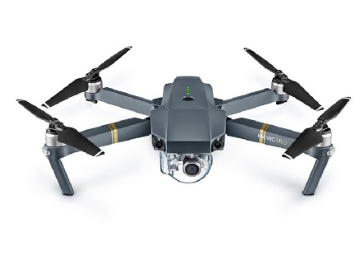
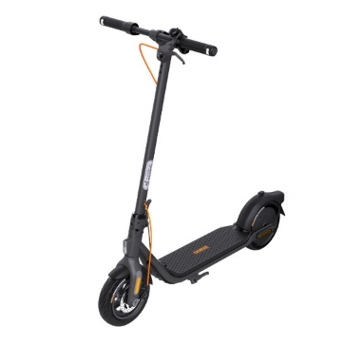
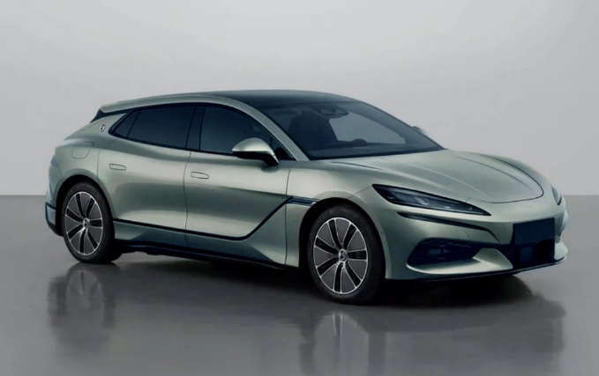
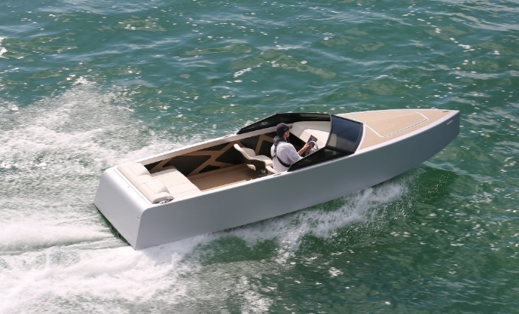
We believe that charging should be simple and invisible

Slide 2
INTRODUCTION
Vision
To lead the transition to sustainable transportation through innovative, wireless charging solutions.
Mission
To create advanced wireless charging technology for electric vehicles, improving efficiency and user experience while reducing environmental impact.
Tagline
WE believe that charging should be simple and invisible.

Slide 3
Team
Institutions that supported our project
CEO
Dejan Janjić MsC
Co-Founder
COO
Branko Koprivica PhD
Co-Founder
CTO
Aleksandar Spasojević
Co-Founder
Business experience:
Leading family company for 20 years
Technical experience:
Designing low and high-power electronics
Project experience:
Project management
Protection of intellectual property
Technical experience:
Measurements and instrumentation
Project experience:
Production of electronic boards
Technical experience:
Assasment and analysis of electronic
Faculty of Technical Sciences in Čačak,
Science and Technology Park Čačak,
Innovation Fund of Republic of Serbia,
Chamber of Commerce of Serbia.

Slide 4
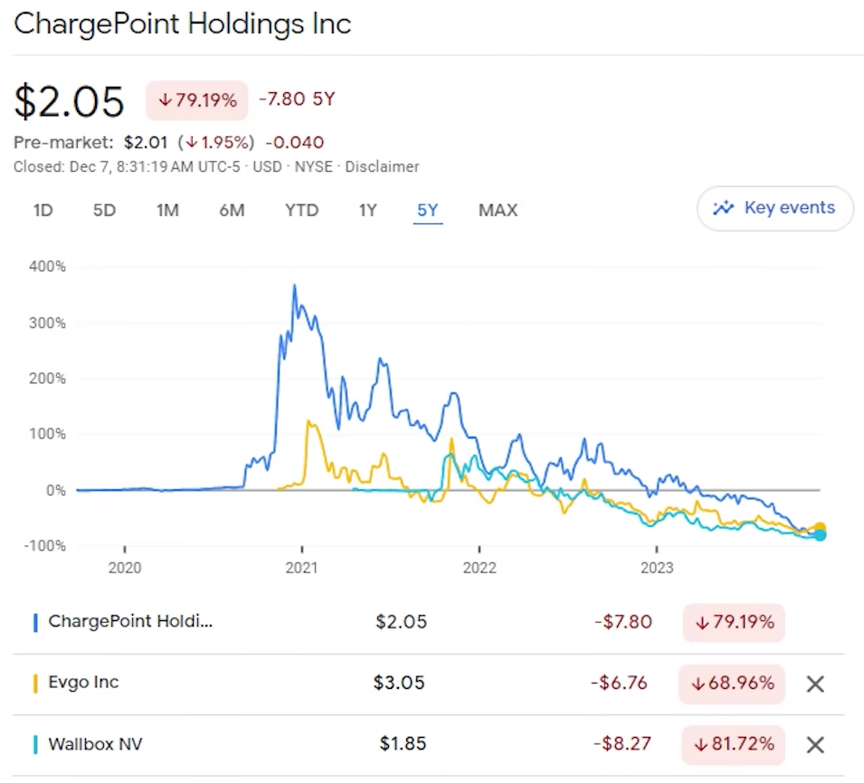
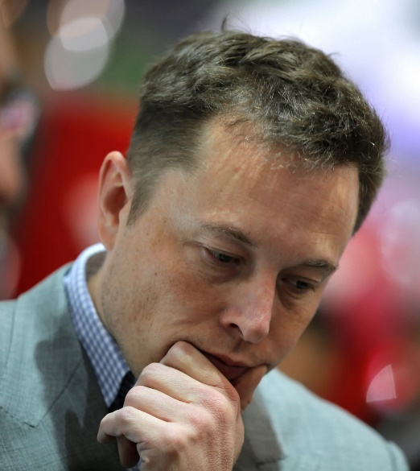
Problem
Largest charging companies lose value in the market
Up to 30% EV users do not want to buy EV again
Reduced EVs sale

Slide 5
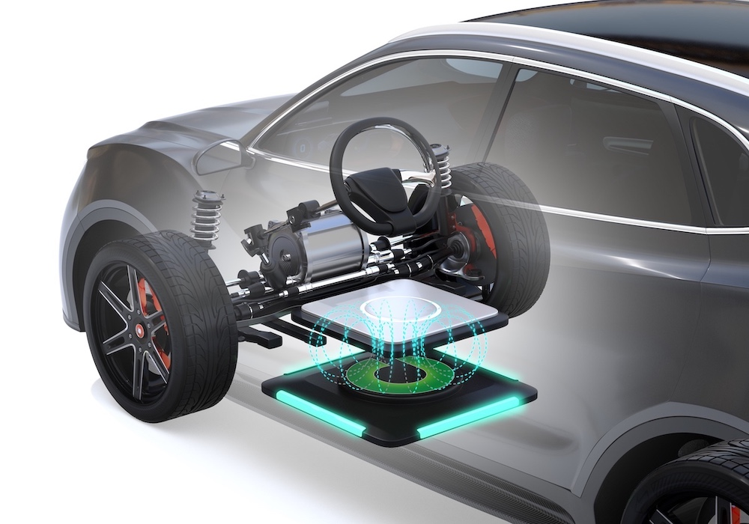
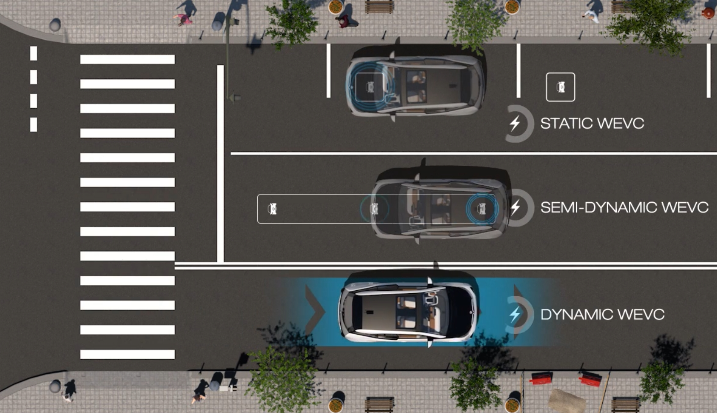
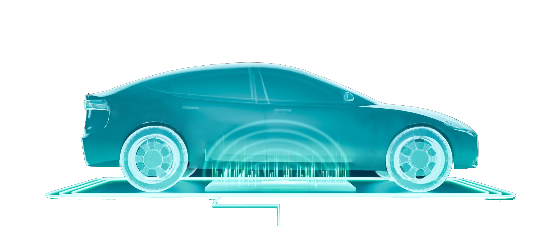
Solution
The solution to 50% of these problems is wireless charging
I am happy!
No problems with:
connectors,
cables,
wired communications,
influence the weather (rain, snow or ice).
Charging is enabled at:
every parking space,
every stopping point,
while driving (charging road).
Application of wireless charging gives:
more satisfied users
lower loss to companies.

Slide 6
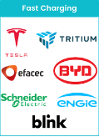
Market and early adopters
EV vehicles and EV Chargers
Manufacturers
Energy Storage and
Smart grid Providers
Key Customer Segments
EV Manufacturers
Fleet Operators (Taxi, Logistics, Public Transport)
Charging Network Providers and Infrastructure Companies
Municipalities and Smart City Initiatives
Industrial Automation and Robotics Companies

Slide 7
COMPETITION
Our main competitors include:
WiTricity
Qualcomm
Plugless Power
Evatran
However, our unique value proposition (UVP) lies in providing a more scalable, efficient, and cost-effective wireless charging solution tailored for various electric vehicles (cars, scooters, drones). Unlike traditional wired chargers, our technology offers greater convenience and sustainability, positioning us as a strong alternative in the rapidly growing EV market.

Slide 8
Market Validation and Industry Interest
Industry Validation and Stakeholder Feedback - Conversations with Key Players
Charge&GO (EV charging network in Serbia)
ElevenEs (Battery manufacturer)
Premier Taxi (Taxi fleet operator)
Survey Results
87% of respondents believe wireless charging would be more convenient than wired charging.
68% would prefer EVs with wireless charging capability as standard equipment.
81% believe dynamic wireless charging (while driving) would be useful in traffic-heavy areas.

Slide 9
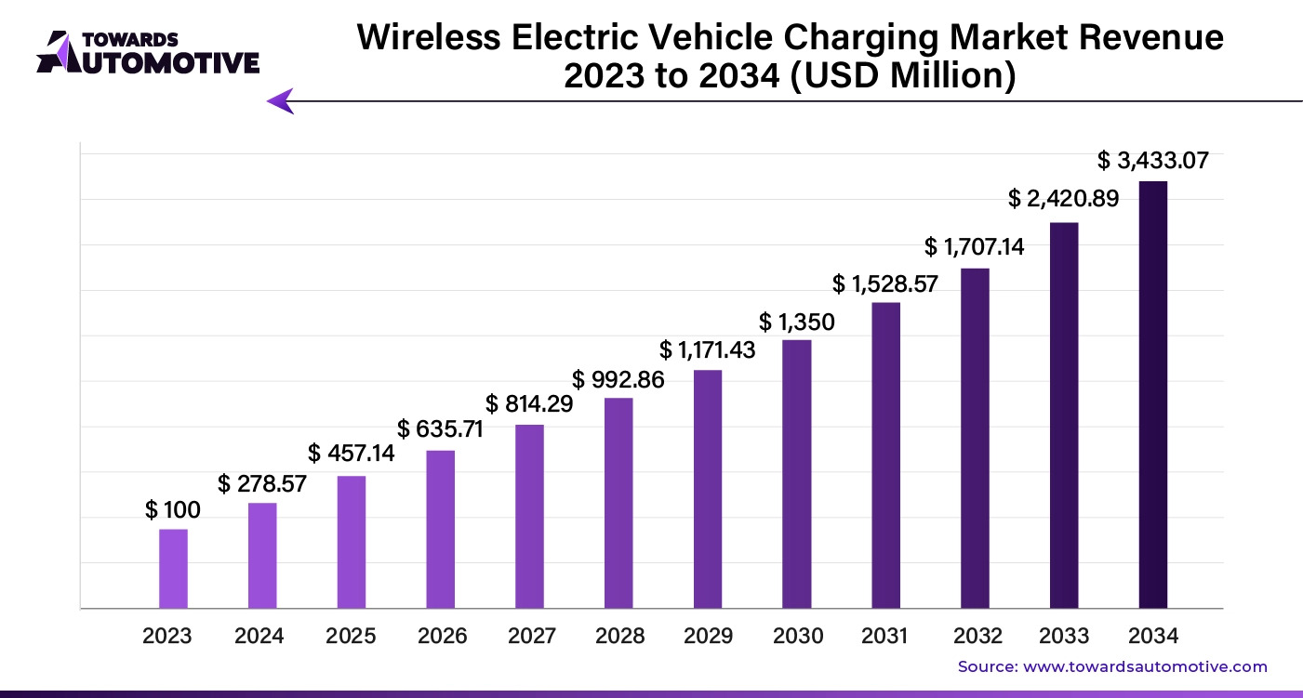
Financial Strategy
Projected Market Growth
The global wireless EV charging market is expected to grow from $100M in 2023 to $1.35B by 2030.
Early adoption by taxi fleets, logistics companies, and municipalities will drive the first wave of demand.

Slide 10
Financial Strategy
Investment and Growth Plan for EVs
Phase | Key Milestones | Funding Needs
Pilot Testing (2025-26) | Grant or Partnership with key industry players | Up to €500K
Product Optimization (2026-27) | Improve efficiency, reduce production costs | €1.5M
Market Expansion (2027-29) | Large-scale deployment in EU & US | €5M+
Investment needs
Scaling MVP to production-ready system
IP protection, regulatory compliance and certifications
Expanding business development efforts

Slide 11
THANK YOU!
Join us in charging the future.
Invest in a greener tomorrow!
www.wptenergy.com
office@wptenergy.com

